Slide 1
Cyber security
Assignment-1

Slide 2
What is cyber security
The technique of protecting internet-connected systems such as computers, servers, mobile devices, electronic systems, networks, and data from malicious attacks is known as cybersecurity. We can divide cybersecurity into two parts one is cyber, and the other is security. Cyber refers to the technology that includes systems, networks, programs, and data. And security is concerned with the protection of systems, networks, applications, and information. In some cases, it is also called electronic information security or information technology security.

Slide 3
Types of cyber security
Every organization’s assets are the combinations of a variety of different systems. These systems have a strong cybersecurity posture that requires coordinated efforts across all of its systems. Therefore, we can categorize cybersecurity in the following sub-domains:
Network security
Application security
Information or data security
Identity management
Operational security
Mobile security

Slide 4
Network Security:
It involves implementing the hardware and software to secure a computer network from unauthorized access, intruders, attacks, disruption, and misuse. This security helps an organization to protect its assets against external and internal threats.
Application Security:
It involves protecting the software and devices from unwanted threats. This protection can be done by constantly updating the apps to ensure they are secure from attacks. Successful security begins in the design stage, writing source code, validation, threat modeling, etc., before a program or device is deployed. Information or Data Security:
It involves implementing a strong data storage mechanism to maintain the integrity and privacy of data, both in storage and in transit. Identity management:
It deals with the procedure for determining the level of access that each individual has within an organization. Operational Security:
It involves processing and making decisions on handling and securing data assets. Mobile Security:
It involves securing the organizational and personal data stored on mobile devices such as cell phones, computers, tablets, and other similar devices against various malicious threats. These threats are unauthorized access, device loss or theft, malware, etc.

Slide 5
Importance of cyber security
Today we live in a digital era where all aspects of our lives depend on the network, computer and other electronic devices, and software applications. All critical infrastructure such as the banking system, healthcare, financial institutions, governments, and manufacturing industries use devices connected to the Internet as a core part of their operations. Some of their information, such as intellectual property, financial data, and personal data, can be sensitive for unauthorized access or exposure that could have negative consequences. This information gives intruders and threat actors to infiltrate them for financial gain, extortion, political or social motives, or just vandalism.
Cyber-attack is now an international concern that hacks the system, and other security attacks could endanger the global economy. Therefore, it is essential to have an excellent cybersecurity strategy to protect sensitive information from high-profile security breaches. Furthermore, as the volume of cyber-attacks grows, companies and organizations, especially those that deal with information related to national security, health, or financial records, need to use strong cybersecurity measures and processes to protect their sensitive business and personal information.

Slide 6
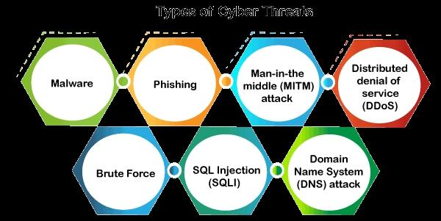
Types of cyber security threads
A threat in cybersecurity is a malicious activity by an individual or organization to corrupt or steal data, gain access to a network, or disrupts digital life in general. The cyber community defines the following threats available today

Slide 7
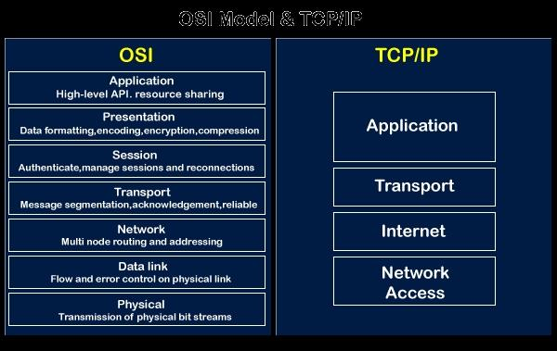
Osi and tcp/ip model

Slide 8
Dash board of cisco packet tracer
Cisco Business Dashboard is a network management tool for Cisco Business switches, routers, and wireless access points. It simplifies the job of managing a business network by automating the deployment, monitoring, and lifecycle management of the network. For managed service providers (MSPs), Cisco Business Dashboard offers the additional benefits of multitenancy and integration with the leading service automation (PSA) and remote monitoring and management (RMM) services, along with leading team collaboration tools

Slide 9
What is phyton
Python is a high-level, general-purpose, and interpreted programming language used in various sectors including machine learning, artificial intelligence, data analysis, web development, and many more. Python is known for its ease of use, powerful standard library, and dynamic semantics. It also has a large community of developers who keep on contributing towards its growth. The major focus behind creating it is making it easier for developers to read and understand, also reducing the lines of code. Being one of the most powerful, and versatile programming languages, Python is easy to learn and is widely used among developers. Its popularity and demand is increasing ever since its launch and still continuing to grow. Demand for Python developers has increased by 41% in the last 5 years. Out of 25 million developers in the world, 8.2 million are Python developers. It is a must-have skill for programmers, data scientists, and developers across many industries. Python, being so popular and highly demanding is ranked as the top programming language, according to several reports

Slide 10
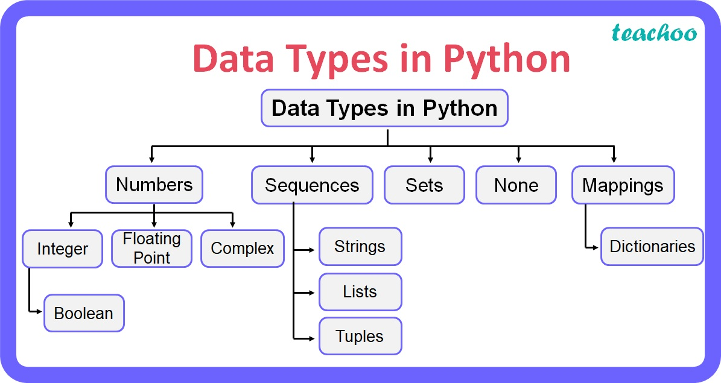
Data types

Slide 11
Introduction to web application
It is a type of computer program that usually runs with the help of a web browser and also uses many web technologies to perform various tasks on the internet.
A web application can be developed for several uses, which can be used by anyone like it can be used as an individual or as a whole organization for several reasons.
In general, a web application can contain online shops (or we can also say them e-commerce shops), webmail's, calculators, social media platforms, etc. There is also some kind of web application that usually requires a special kind of web browser to access them. We cannot access those kinds of web applications by using regular web- browsers. However, most of the web applications available on the internet can be accessed using a standard web browser.

Slide 12
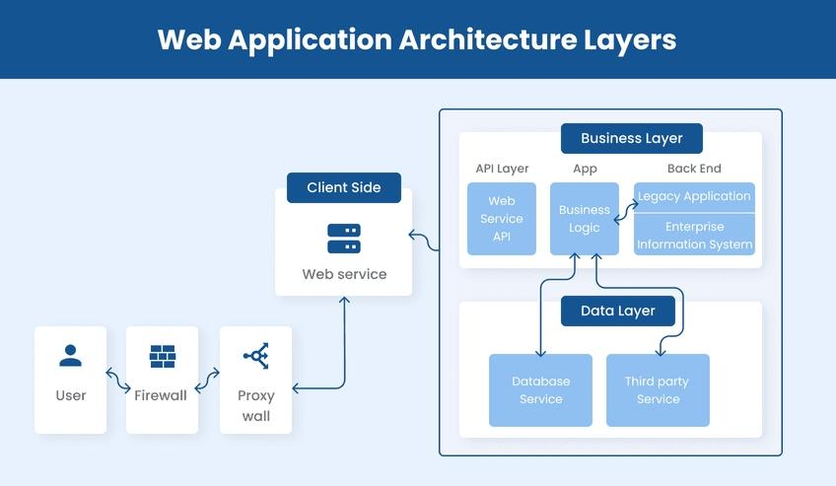
Architecture of web application

Slide 13
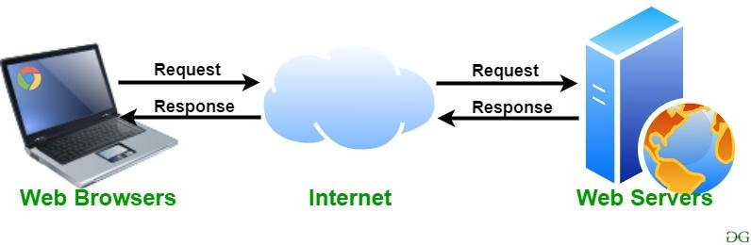
Web service
A web server is software and hardware that uses HTTP (Hypertext Transfer Protocol) and other protocols to respond to client requests made over the World Wide Web. The main job of a web server is to display website content through storing, processing and delivering webpages to users.

